Slide 1
Crime Type and Occurrence Prediction using Machine Learning
Project guide:
B. Mallaiah
Presented by:
T.Sai Teja [19E31A1226]
Nabeela kaleem [19E31A1231]
D.Madhuri [19E31A1206]
G.Sai Siddhartha [19E31A1207]

Slide 2
CONTENTS
ABSTRACT
INTRODUCTION
EXISTING SYSTEM
PROPOSED SYSTEM
SYSTEM REQUIRMENTS
SYSTEM ARCHITECTURE
MODULES
ALGORITHMS
UML DIAGRAMS
CONCLUSION
FUTURE SCOPE

Slide 3
Abstract
Crime is an alarming aspect of our society, and its prevention is a vital task. Crime analysis is a well-organised way of detecting and examining patterns and trends in crime.The primary objective of this project is to distinguish various crimes using clustering techniques based on the occurrences and regularity.
Data mining is used for analysis, investigation and check patterns in crimes. In this project, a clustering approach is used to analyse the crime data; the stored data is clustered using the K-Means algorithm. After the classification and clustering, we can predict a crime based on its historical information.

Slide 4
Introduction
The objective would be to train a model for prediction. The training would be done using the training data set which will be validated using the test dataset. Building the model will be done using better algorithm depending upon the accuracy. The K-means clustering and few classification algorithm will be used for crime prediction. Visualization of dataset is done to analyze the crimes which may have occurred in the particular state. This work helps the law enforcement agencies to predict and detect crimes in India with improved accuracy and thus reduces the crime rate.

Slide 5
Existing Work
In data collected from various websites, newsletter was used for prediction and classification of crime using Naive Bayes algorithm and decision trees and found that former performed better.
In a thorough study of various crime prediction method like Support Vector Machine(SVM), Artificial neural networks(ANN) was done and concluded that there does not exist particular method which can solve different crime datasets problems.
The K-Means clustering was implemented and their performance is evaluated on the basis of accuracy. On comparing the performance of different clustering algorithm DBSCAN gave result with highest accuracy and KNN classification algorithm is used for crime prediction.

Slide 6
Proposed System
There are many machine learning algorithms available to users that can be implemented on datasets. However, there are two major types of learning algorithms: supervised learning and unsupervised learning algorithms. Using unsupervised learning we will create number of clusters and will create labels respectively based on K-means clustering. Supervised learning algorithms work by inferring information or "the right answer" from labeled training data. The algorithms are given a particular attribute or set of attributes to predict. Data preprocessing process includes methods to remove any null values or infinite values which may affect the accuracy of the system.
Advantages
Accuracy improvised
Crime prediction intends to reduce crime occurrences
It does this by predicting which type of crime may occur in future

Slide 7
System Requirements
Hardware:
OS – Windows 7, 8 and 10 (32 and 64 bit)
RAM – 4GB
Software:
Python Language
Anaconda Navigator
jupyter Notebook

Slide 8
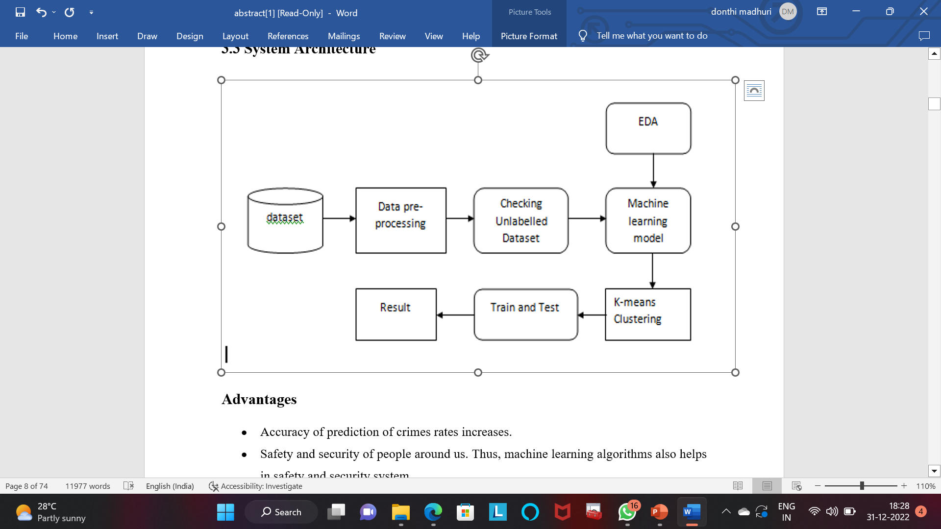
System Architecture

Slide 9
MODULES
DATA COLLECTION
DATA PRE-PROCESSING
FEATURE EXTRACTION
EVALUATION MODEL

Slide 10
DATA COLLECTION
Data collection is a process in which information is gathered from many sources.
This data is later used to develop the machine learning models.
In this step the data set is converted into the understandable format which can be fed into machine learning models.

Slide 11
DATA PRE-POCESSING
Organize the selected data by formatting, cleaning and sampling.
Formatting :The data you have selected may not be in a format that is suitable for you to work with .The data may be in a relational database and you would like it in a flat file.
Cleaning :Cleaning data is removal or fixing of missing data.
Sampling: There may be far more selected data available than you need to work with.

Slide 12
FEATURE EXTRACTION
Feature extraction is an attribute reduction process.
The transformed attributes, or features, are linear combinations of the original attributes.

Slide 13
EVALUATION MODEL
Model Evaluation is an integral part of the model development process.
This model represents our data and how well the chosen model will work in the future.

Slide 14
Algorithms Used
K-Means Clustering Algorithm
Random Forest Algorithm
Logistic Regression
Support Vector Machine

Slide 15
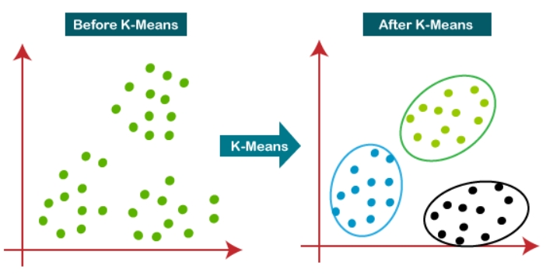
K-MEANS CLUSTERING ALGORITHM
K-Means Clustering is an Unsupervised learning algorithm which groups the unlabelled dataset into different clusters. Here K defines the number of pre-defined clusters that need to be created in the process, as if K=2, there will be two clusters, and for K=3, there will be three clusters, and so on.
It is an iterative algorithm that divides the unlabeled dataset into k different clusters in such a way that each dataset belongs only one group that has similar properties.

Slide 16
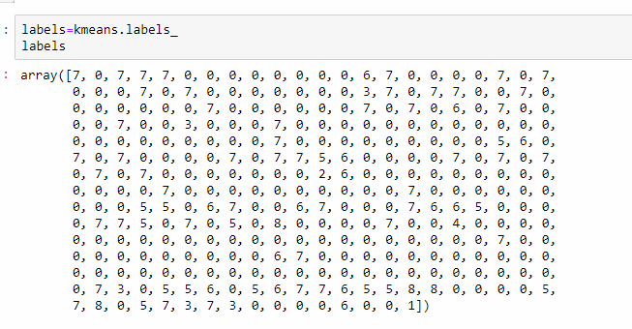
Labels Generated by K-Means

Slide 17
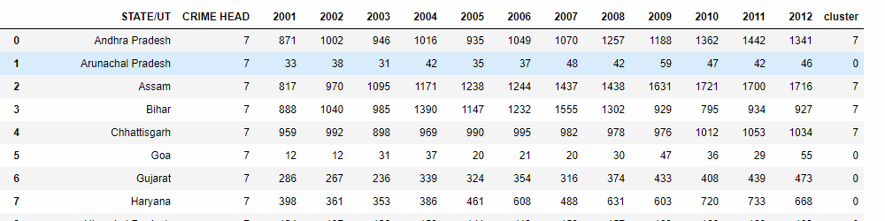
K-Means Result

Slide 18
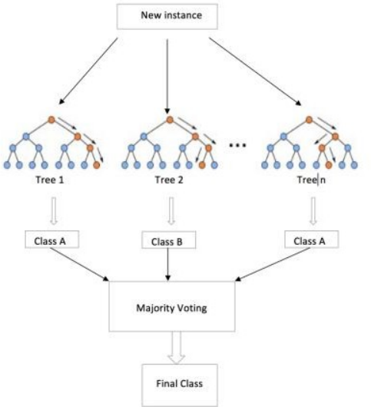
RANDOM FOREST ALGORITHM
Random forest is a type of supervised machine learning algorithm based on ensemble learning. Ensemble learning is a type of learning where you join different types of algorithms or same algorithm multiple times to form a more powerful prediction model.
The random forest algorithm combines multiple algorithms of the same type i.e. multiple decision trees, resulting in a forest of trees, hence the name "Random Forest". The random forest algorithm can be used for both regression and classification tasks.

Slide 19
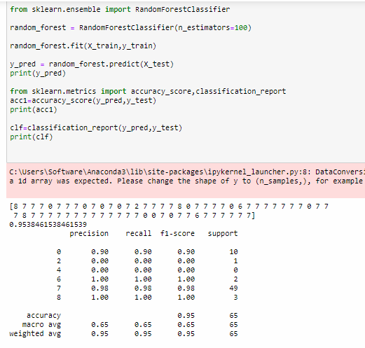
Accuracy result with Random Forest

Slide 20
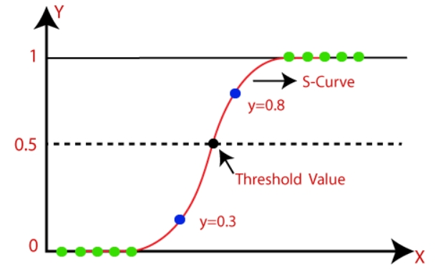
LOGISTIC REGRESSION
Logistic regression is one of the most popular Machine Learning algorithms, which comes under the Supervised Learning technique. It is used for predicting the categorical dependent variable using a given set of independent variables.
Logistic regression predicts the output of a categorical dependent variable. Therefore the outcome must be a categorical or discrete value. It can be either Yes or No, 0 or 1, true or False, etc. but instead of giving the exact value as 0 and 1, it gives the probabilistic values which lie between 0 and 1.

Slide 21
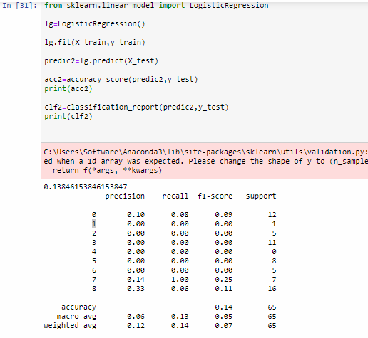
Accuracy Result with Logistic Regression

Slide 22
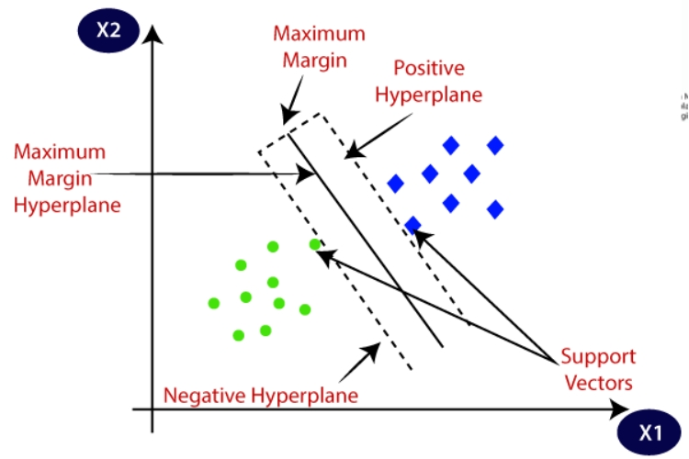
Support Vector Machine (SVM)
Support Vector Machine (SVM) is a supervised machine learning algorithm which can be used for both classification and regression challenges. It is generally utilized in characterization issues. In the SVM, we plot every given thing as a point in n-dimensional space with the calculation of each element being the estimation of a specific arrange.
Bolster Vectors are essentially the co-ordinates of individual perception. The SVM classifier is a
wilderness which best isolates the two classes
(hyper-plane/line).

Slide 23
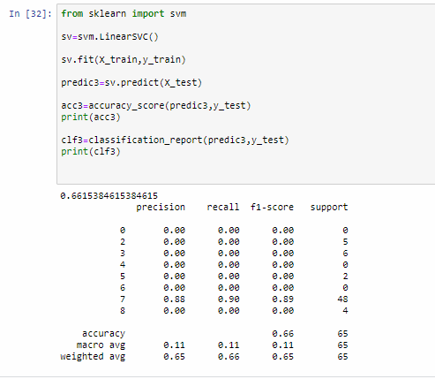
Accuracy result with SVM

Slide 24
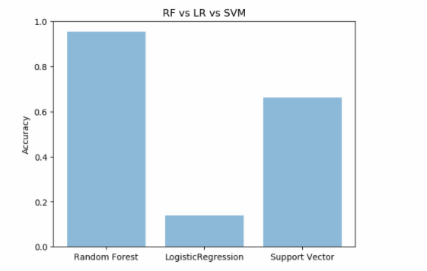
Comparative model Accuracy graph

Slide 25
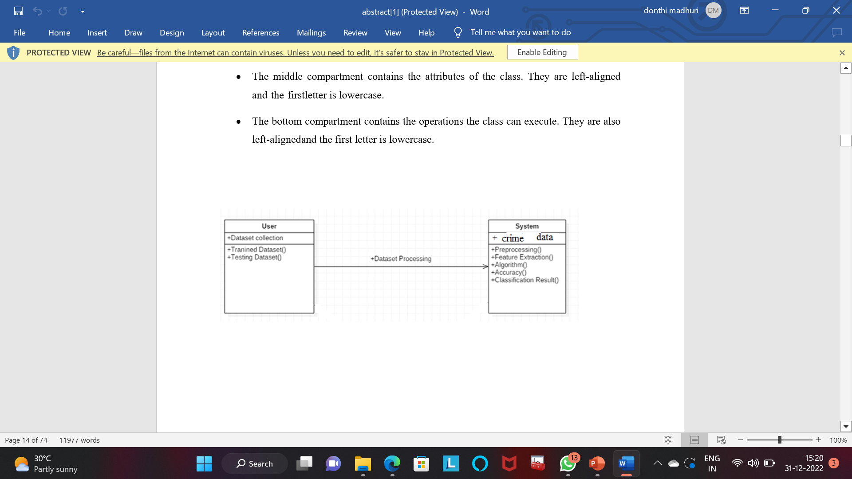
UML DIAGRAMS
Class Diagram
Class Diagram is the main building block
of object-oriented modelling.
A class consists of its objects,and also
it may inherit from other classes.

Slide 26
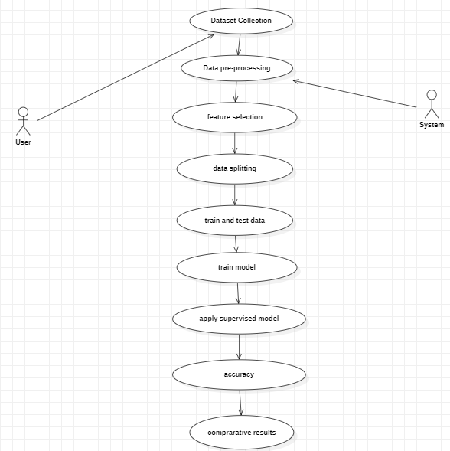
Use-case Diagram
Use-case diagrams describe the
high-level functions and scope of a
system.
These diagrams alsoidentify the
interactions between the system
and actions.

Slide 27
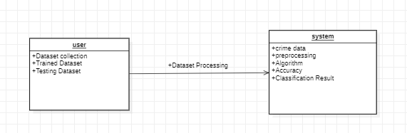
Object Diagram
Object diagram use notation
that is similar to that used
in class diagram.
Objects help in portraying a
static view of an object –
oriented system at a specific
instant.

Slide 28
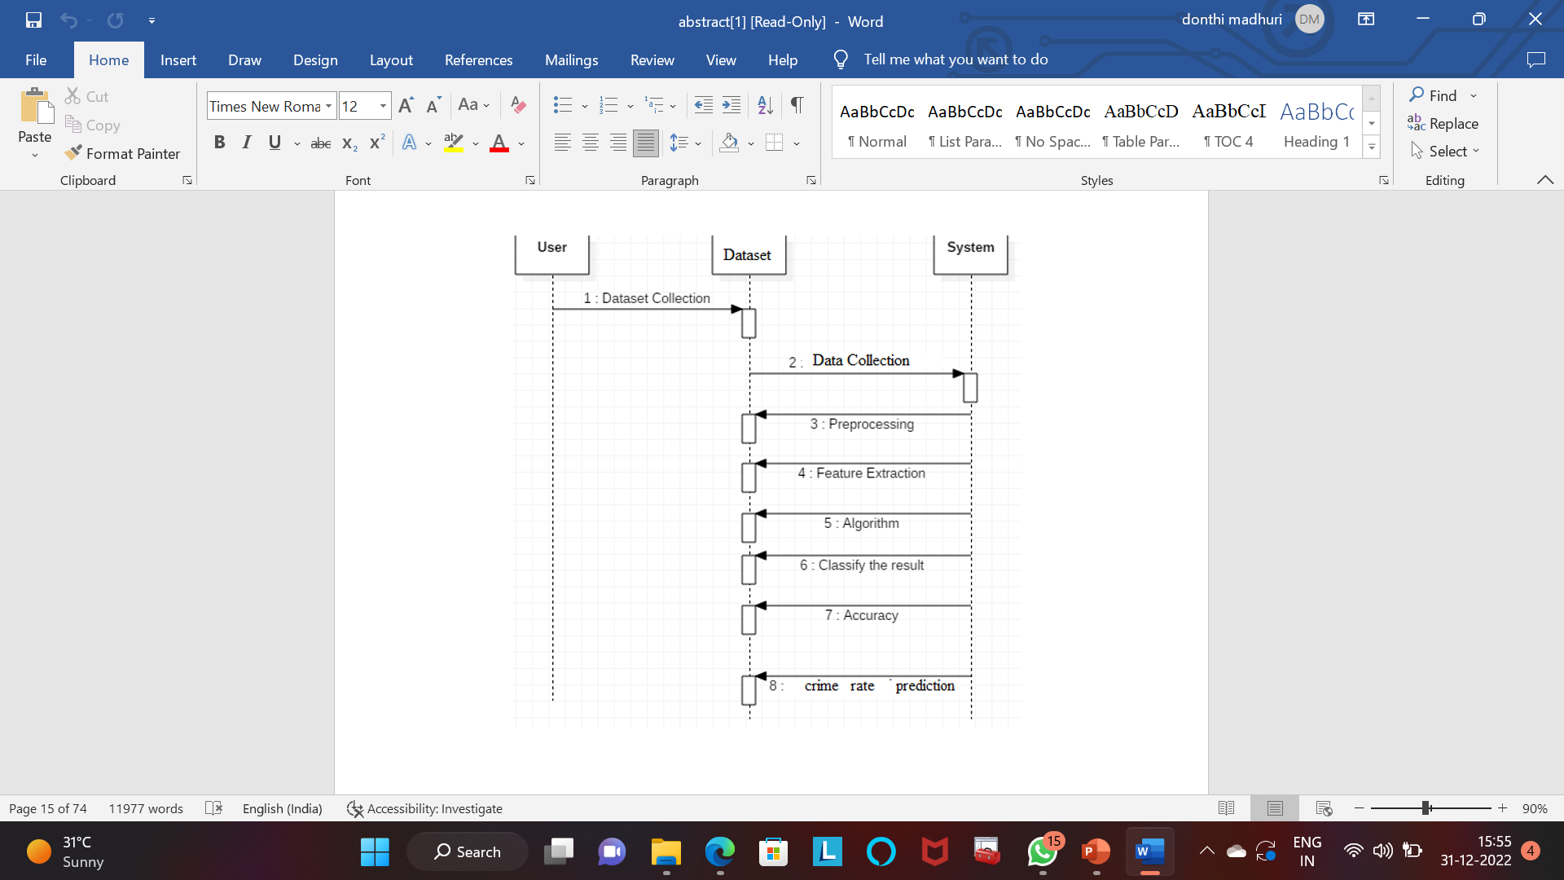
Sequence Diagram
It represents the object
participating the interaction
horizontally and time
vertically.
Message flow is represented
by vertical doted lines.

Slide 29
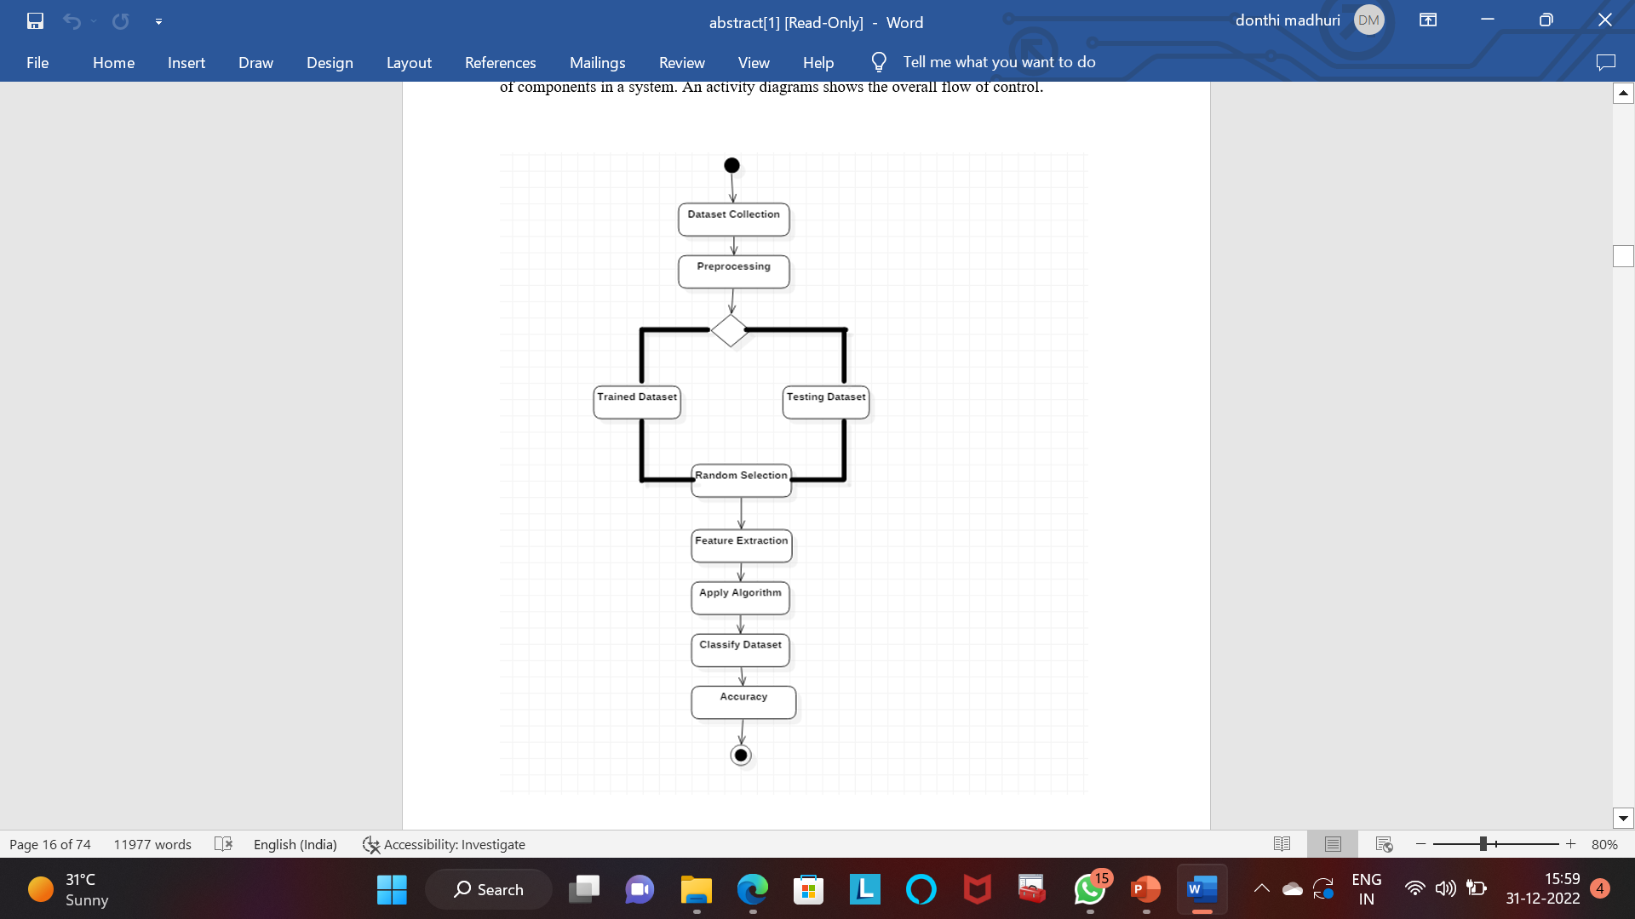
Activity Diagram
Activity diagram are
representation of
workflows of stepwise
activities and actions
with support for choice,
iteration and concurrency.

Slide 30
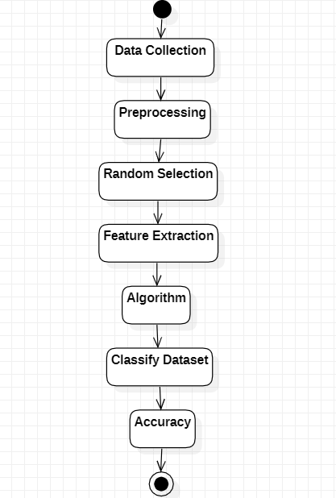
State chart Diagram
State chart describe
a state machine.
States are controlled
by the internal or
external events.

Slide 31
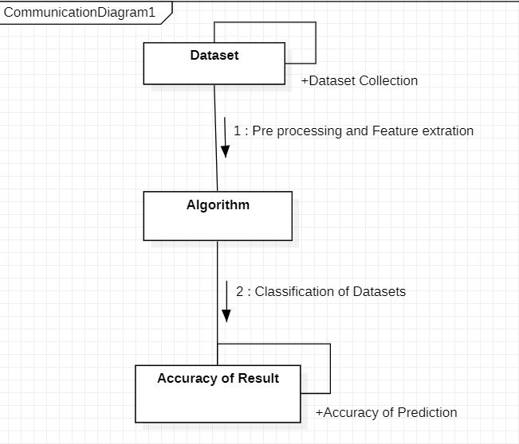
Collaboration Diagram
It describes the relationships and
interactions among software objects
in the Unified Modeling Language.

Slide 32
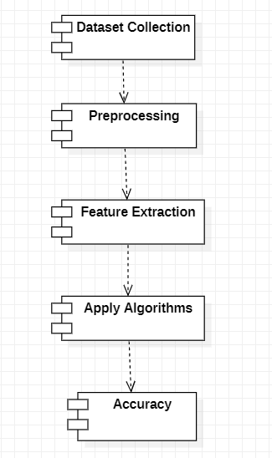
Component Diagram
Component diagram is used
to break down a large object-
oriented system into the smaller
components.
It visualizes the relationships as
well as the organization between
the components present in the
system.

Slide 33
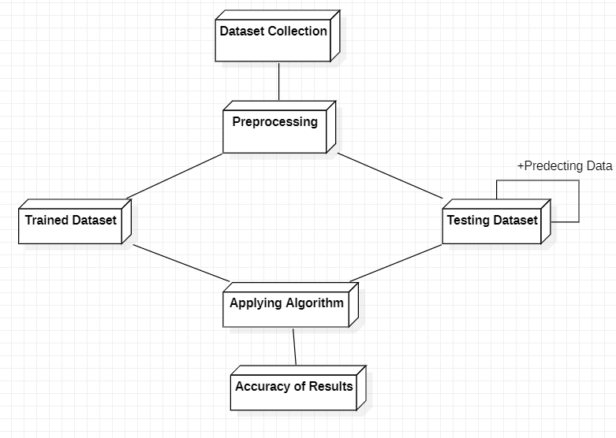
Deployment Diagram
Deployment diagram are
typically used to visualize
the physical hardware and
software of a system.
It involves the nodes and their
relationships.

Slide 34
Conclusion
Crime prediction is one the current trends in the society. Crime prediction intends to reduce crime occurrences. It does this by predicting which type of crime may occur in future.
Here, analysis of crime and prediction are performed with the help of various approaches. From the results obtained we saw that the training time of Random Forest is very high.
However which model will work best is totally dependent on the dataset that is being used.

Slide 35
Future Scope
As of now, the project relies on manual input from a human (a police officer) in order to enter details in the database. If we can make this a centralised system and connect it to all the police stations countrywide and make FIR reporting digital, then it would be quite easier to predict crimes in that particular location and recognise patterns in them.

Slide 36
THANK YOU

